Slide 1
UNIT-2
C PROGRAMMING

Slide 2
A program is a set of instructions that a computer follows in order to perform a particular task.
A programming language is a computer language that is used by programmers (developers) to communicate with computers. It is a set of instructions written in any specific language ( C, C++, Java, Python) to perform a specific task.
A programming language is mainly used to develop desktop applications, websites, and mobile applications.
Types of programming language
Low-level programming language
High-level programming language
Middle-level programming language

Slide 3
DEFINITION OF C PROGRAMMING
The C Programming Language is a procedural, imperative, and general-purpose language utilized for coding applications that can run across multiple platforms.
The C Language is developed by Dennis Ritchie for creating system applications that directly interact with the hardware devices such as drivers, kernels, etc.
C programming is considered as the base for other programming languages, that is why it is known as mother language.
The most of UNIX operating system are written in C language.

Slide 4
FEATURES OF C PROGRAMMING
Simple and Efficient
Modularity/Structured Programming Language.
Portability
Middle level Language
General Purpose Programming Language
Speed
Powerful
Rich Standard Library
Syntax Based Language
Format Free Language
Case Sensitive language

Slide 5
APPLICATIONS OF C LANGUAGE
Operating Systems
Graphical User Interface
New Programming Platforms
Google
Mozilla Firefox and Thunderbird
MySQL
Compiler Design
Gaming and Animation etc.

Slide 6
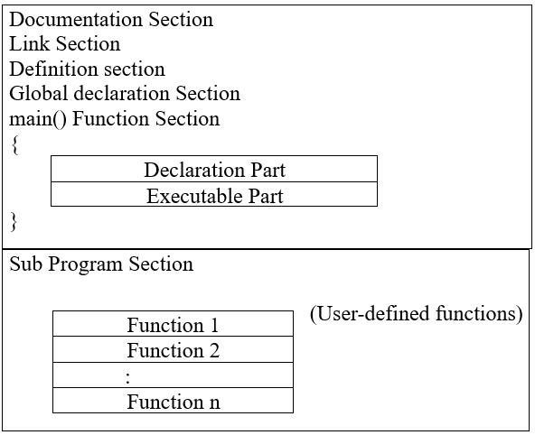
BASIC STRUCTURTE OF C PROGRAM

Slide 7
1. Documentation Section:- It is the section in which you can give comments to make the program more interactive. The compiler won’t compile this and hence this portion would not be displayed on the output screen.
2. Preprocessor directives Section or Link Section:-
This section involves the use of header files that are to included necessarily program.
3. Definition section:-
This section involves the variable definition and declaration in C.
4. Global declaration Section:-
This section is used to define the global variables to be used in the programs, that means you can use these variables throughout the program.

Slide 8
5. Function prototype declaration section:-
This section gives the information about a function that includes, the data type or the return type, the parameters passed or the arguments.
6. Main function:-
It is the major section from where the execution of the program begins. The main section involves the declaration and executable section.
7. User-defined function section:-
When you want to define your function that fulfills a particular requirement, you can define them in this section.

Slide 9
Programming Style:-
All Statements should be in lowercase letters and upper case letters are only used for symbolic constants.
Programmer can write the statements any where between the two braces following declaration part.
The user can also write more than one statement in one line separating them with a semicolon.
The opening and closing braces should be balanced.
Use comments whenever necessary. Comments increases the program readability and also help to understand the logic.

Slide 10
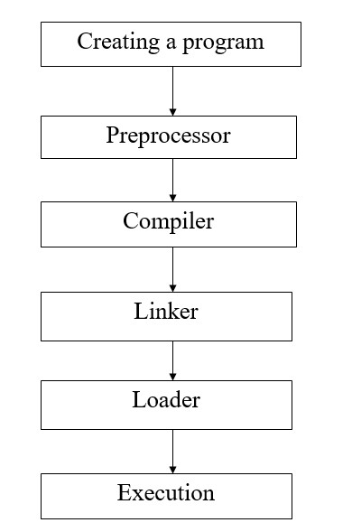
Creating and Executing C Program

Slide 11
MODULAR PROGRAMMING
Modular Programming is a program design technique in which a large program is divided into sub programs/functions that are called modules.
It improves maintainability of a program.
It makes software development , debug, modify, update faster and easy.

Slide 12
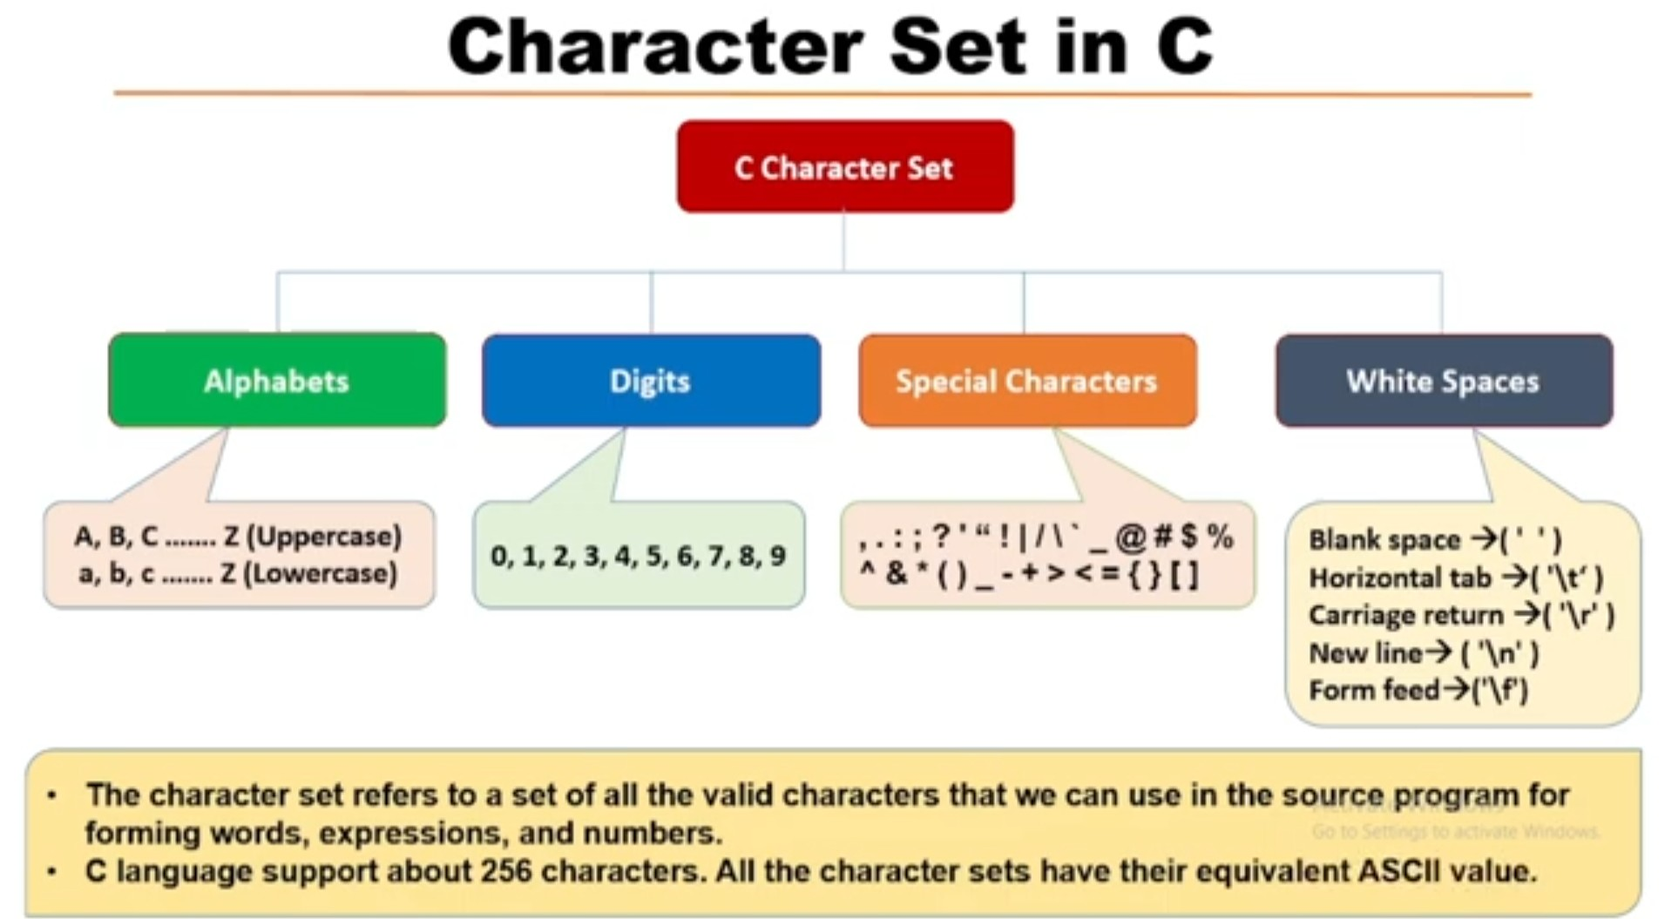

Slide 13
C TOKENS
A token in C can be defined as the smallest individual element of the C programming language that is meaningful to the compiler.
OR
One or more characters grouped together to form basic elements of C are known as C Tokens.
Types of Tokens in C
Keywords
Identifiers
Constants
Strings
Special Symbols
Operators

Slide 14
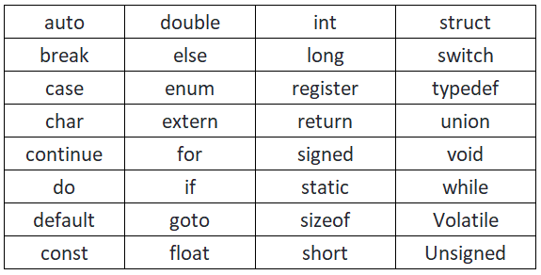
Keywords
The keywords are reserved for specific meanings in C language.
When keywords are combined with the formal syntax, it forms the C programming language.
C language supports 32 keywords which are given below:

Slide 15
Identifiers
Identifier is a name given to variable , function or any other user defined item.
Identifiers must be unique. They are created to give a unique name to an entity to identify it during the execution of the program.
For example:
int money;
double accountBalance;
Here, money and accountBalance are identifiers.

Slide 16
Rules for Identifiers
They must begin with a letter or underscore(_).
They must consist of only letters, digits, or underscore. No other special character is allowed.
It should not be a keyword.
It should be a single word. i.e, No blank space is allowed.
Identifiers are case-sensitive.
The maximum length of an identifier is 31 characters.
For example,
main: method name.
a: variable name.

Slide 17
Special Symbols
Semicolon(;)
Brackets[]
Parentheses()
Braces{}
Comma (, )
Colon(:)
Asterisk (*)
Assignment operator(=)
Pre-processor (#)
Period (.)
Tilde(~)

Slide 18
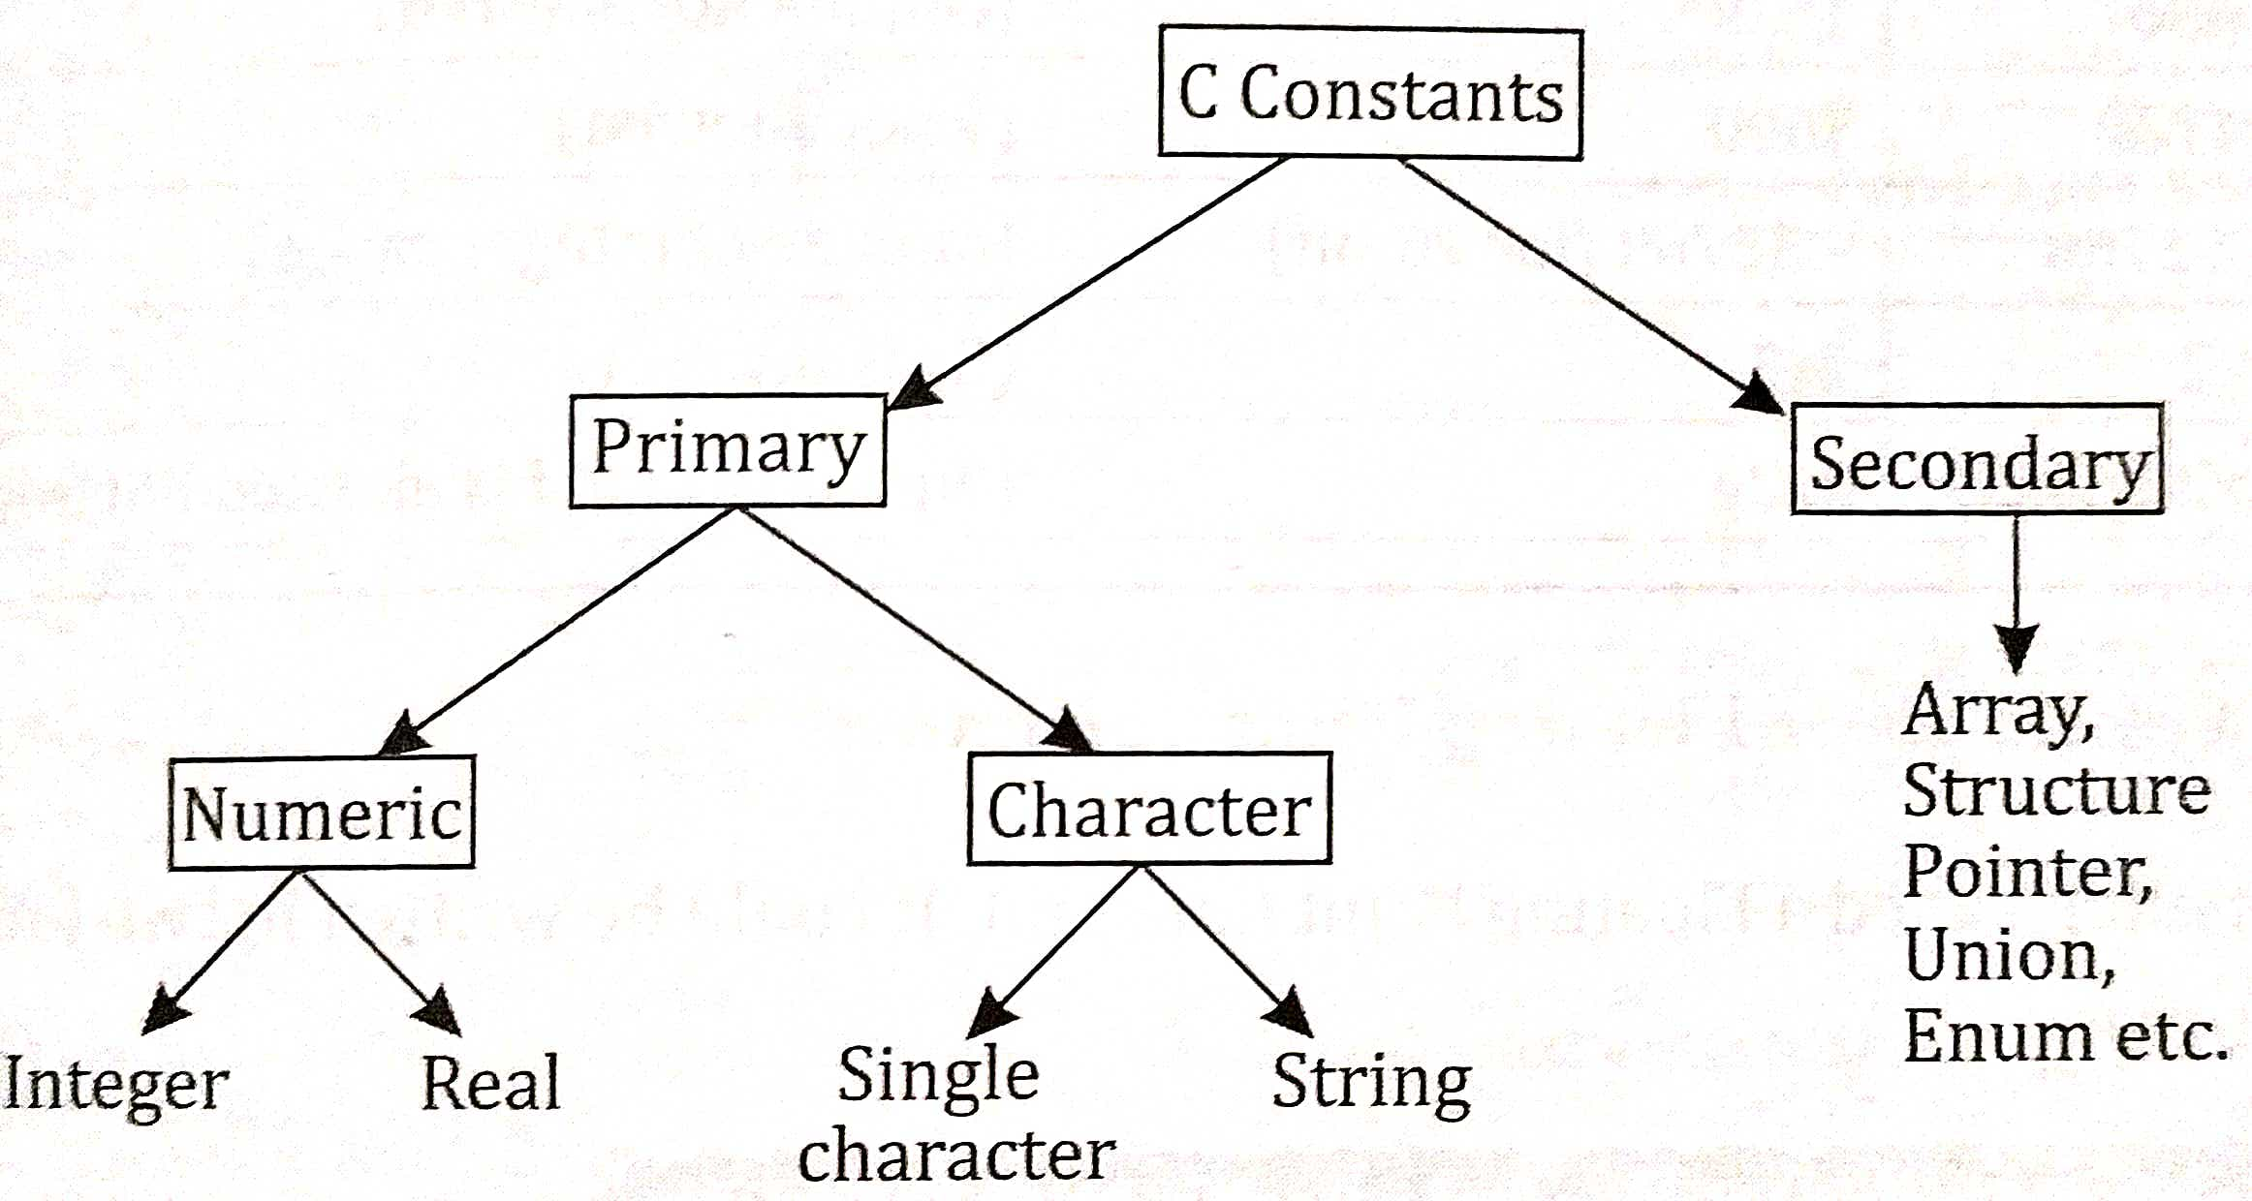
Constants
Constants in C refer to the fixed values that do not change during the execution of a program. OR
A Constant is a token with fixed value that does not change.
There are two types of constants in C: Primary and Secondary Constants.

Slide 19
Integer Constants: It refers to a sequence of digits.
Example:- 650 , +666, -100, -32000
Real Constants : it is often called a Floating point constant.
Example:- 426.00, -66.6666, +.5
Character Constants: It consists of a single character, single digit, or a single special enclosed within a pair of single inverted commas. The maximum length of a character is one character.
Example:- ‘a’ is a character constant.
String Constants: It is a sequence of one or more characters enclosed within a pair of double quotes. The characters may be letters, numbers, special characters and blank spaces.
Example:- “Hello”

Slide 20
Strings
The Strings are nothing but an array of characters ended with a null character (‘\0’).
This null character indicates the end of the string. Strings are always enclosed in double quotes. Whereas, a character is enclosed in single quotes in C and C++.
Examples of String
char string[20] = {‘g’, ’e’, ‘e’, ‘k’, ‘s’, ‘f’, ‘o’, ‘r’, ‘g’, ’e’, ‘e’, ‘k’, ‘s’, ‘\0’};
char string[20] = “geeksforgeeks”;
char string [] = “geeksforgeeks”;

Slide 21
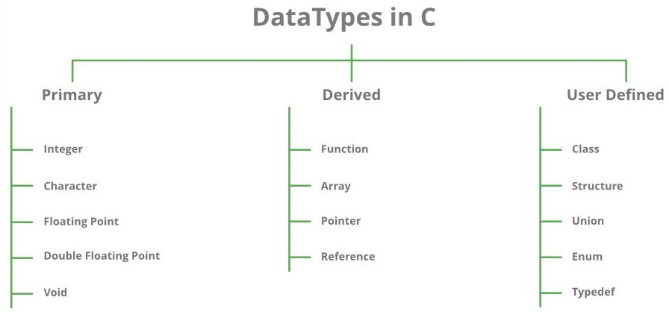
Data Types
It specifies the type of data that the variable can store like integer, character, floating, double, etc.

Slide 22
Basic or Primary Data Types:-
Data Type | Size(in bytes) | Format Specifier | Syntax
int | 4 | %d | int var_name;
float | 4 | %f | float var_name;
double | 8 | %lf | double var_name;
char | 1 | %c | char var_name;

Slide 23
Variables
A Variable is a named location in memory that is used to hold a value that can be modified by the program.
OR
A variable is like a container (storage space) with a name in which you can store data.
Rules to Name a Variable:-
When you create a variable, you should always give a meaningful name to the variable. And follow the below rules for naming the variable:
Variable names must not start with a digit.
The variable name can consist of alphabets, digits, and special symbols like underscore _.
Blank or spaces are not allowed in the variable name.
Keywords are not allowed as a variable name.
Upper and lowercase names are treated as different, as C is case-sensitive, so it is suggested to keep the variable names in lowercase.

Slide 24
int 1var; // incorrect - should not start with number
int var1; // correct
int my$var // incorrect - special characters not allowed
int my_var1; // correct
int my var; // incorrect - spaces not allowed
char else; // can't use Keywords
int count; // valid variable name
int Count; // new variable
int COUNT; // new variable

Slide 25
Syntax for using Variable:-
data_type var_name;
where, data_type is a valid data type (along with datatype modifiers, if required) and var_name is the name of the variable.
For example:- int marks;
marks is the name of the variable, and it can store values of int type.
Assigning value to Variable:-
// variable declaration
int marks;
// variable definition
marks = 10;
int marks = 10; // variable declaration and variable definition in one step

Slide 26
Difference Between Identifier and Variable
Identifiers | Variables
It is used to name a variable, a function, a class, a structure, a union. | It is used to give a name to a memory location that holds a value.
Identifiers are created assign a name to an entity. | Variable is created to assign a unique name to a specific memory location.
All identifiers are not variables. | All the variables names are identifiers.
Identifier can take more number of characters. | Variable takes less number of characters.

